Slide 1

AI PERSONAL ASSISTANT
GURU NANAK COLLEGE (AUTONOMOUS)
A Sikh Minority Institution I A Unit of Guru Nanak Educational Society (Regd.)
Affiliated to University of Madras | Approved by AICTE | Accredited at "A++" Grade by NAAC
Guru Nanak Salai Velachery, Chennai - 600042.
Roll No. : 71213
Register No. : 2313141058015
Name : KACHA BALAJI
Class & Sec. : III A B.Sc COMPUTER SCIENCE
Name of the Guide : Ms. P.Malathi M.C.A., M.Phil.

Slide 2
ABSTRACT
This project presents Neural-Core, an advanced AI Personal Assistant designed to bridge the gap between human intent and system execution. Developed using Python and powered by the Gemini 1.5 Flash model, the assistant utilizes a technical, high-performance UI built with CustomTkinter. The system features a secure authentication gateway and an autonomous function-calling engine, allowing users to control local applications (like Notepad and Edge) and monitor hardware vitals through natural language. By integrating real-time speech recognition and hardware-level diagnostics, Neural-Core provides a seamless, hands-free experience for optimized personal productivity.

Slide 3
SOFTWARE REQUIREMENTS SPECIFICATION (SRS)
Hardware Requirements
Software Requirements
OS: Windows 10 / 11
Language: Python 3.x
GUI Framework: CustomTkinter
AI Engine: Google Gemini API
Processor: Intel i3 or above
RAM: 8 GB Minimum
Storage: 20 GB Free Space
Input: Active Microphone for voice commands

Slide 4
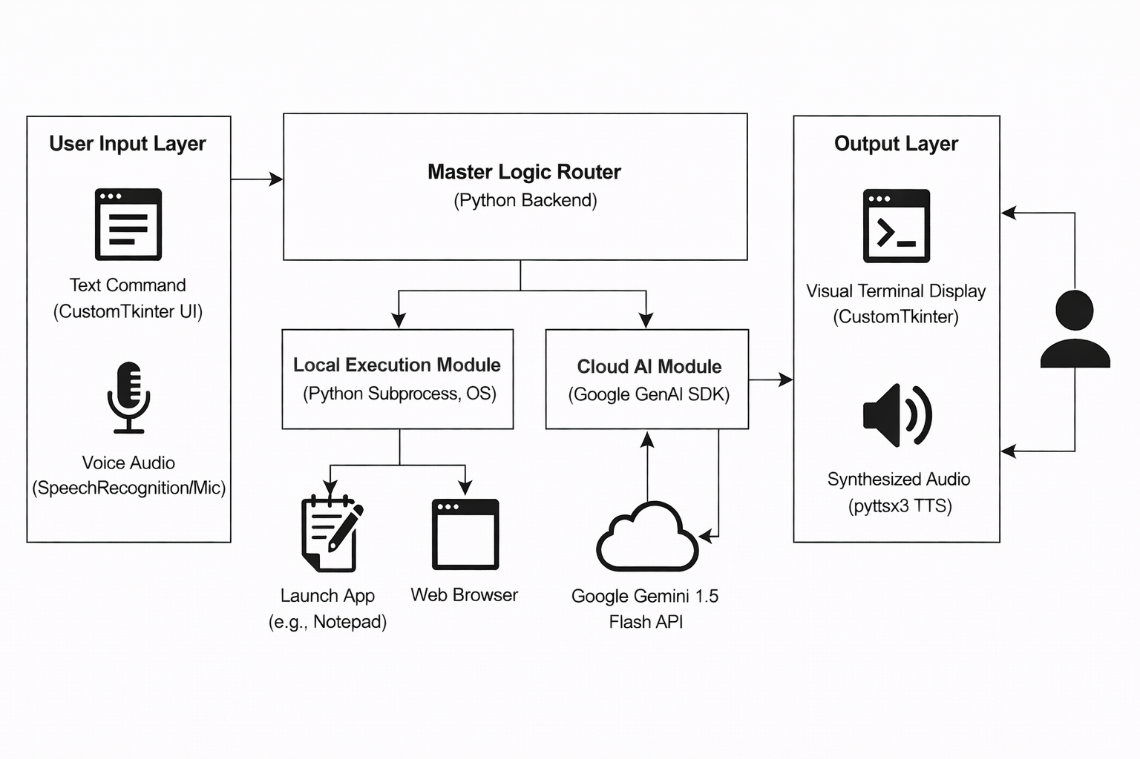
SYSTEM DESIGN
SYSTEM ARCHITECTURE DIAGRAM

Slide 5
4. Database Layer
PostgreSQL Database (Backend)
Stores Users, Courses, Marketplace, and Income data
Ensures secure and structured data management
SYSTEM DESIGN
SYSTEM ARCHITECTURE DIAGRAM
1.User Input Layer:
Text Processing: Developed using CustomTkinter
for a responsive, modern terminal UI.
Voice Interception: Utilizes the SpeechRecognition
library to capture and digitize natural language
through the microphone.
2. Master Logic Router (Python Backend):
Acts as the central nervous system, coordinating data flow between the UI and backend execution modules.
Manages asynchronous threads to prevent the UI from freezing during AI processing
3. Cloud AI Module:
Leverages the Google Gemini 1.5 Flash API for
real-time natural language understanding
Implements JWT Authentication
Performs Intent Classification to determine if a
user wants to launch an app, check hardware, chat.
4. Output Layer:
Provides visual feedback through a live terminal console.
Generates audible responses using the pyttsx3 Text-to-Speech (TTS) engine.

Slide 6
SYSTEM DESIGN
MODULE DESCRIPTION
1. Authentication Module
User Login & Security: Handles the primary entry point for the application, requiring root credentials to authorize system access.
Session Initialization: Once verified, the module starts a new user session and loads individual preferences and mascot assets.
Access Control: Restricts execution of high-level system commands until a secure handshake is established.
Visual Verification: Displays a dedicated login interface featuring a 3D character asset to signify system readiness.
2. Signal Capture & Processing Module
Speech-to-Text (STT): Utilizes a microphone to
intercept voice signals and convert them into digital
strings for AI processing.
Ambient Noise Adjustment: Implements a
calibration phase to sample background sounds and
filter environmental noise for clearer signal reception.
Command Interception: Monitors thes
CustomTkinter terminal for direct text-based user
commands as a fallback for voice.
Real-time Processing: Ensures that captured signals
are immediately forwarded to the Master Logic
Router with minimal latency.

Slide 7
SYSTEM DESIGN
MODULE DESCRIPTION
3. Neural Processing Engine (Core AI)
Intent Classification: Leverages the Google Gemini
1.5 Flash API to analyze user strings and identify the
specific requested action.
Logical Routing: Acts as the central brain, mapping
Classified intents (e.g., "Check Health") to localized
python functions.
Response Generation: Formulates natural language
responses based on the successful execution or failure
of a system task.
Autonomous Decision Making: Determines if a
command requires a local system call or a purely \
conversational response.
4. Hardware Diagnostic Module
Real-time Telemetry: Utilizes the psutil library to pull live data directly from internal hardware sensors.
Metric Monitoring: Specifically tracks CPU load percentage and battery health status including plug-in detection.
Automated Reporting: Formats raw sensor data into a human-readable report for the output terminal.
System Health Alerts: Provides early warnings if system vitals exceed normal operating thresholds.

Slide 8
SYSTEM DESIGN
MODULE DESCRIPTION
5. System Tool Dispatcher
Autonomous Execution: Directly interacts with
operating system to launch local software such as
VS Code, Notepad, or browsers.
Process Management: Initializes applications as independent subprocesses, allowing the assistant to remain active while other apps are running.
OS Command Mapping: Translates natural language requests into specific file paths and executable commands
6. Feedback & Output Module
Visual Matrix Console: Manages a live-scrolling
terminal log that displays every background
operation and AI thought process.
Neural Animation Handler: Controls the pulsing
circular aura on the UI to provide visual cues for
"Listening" and "Thinking" states.
Voice Synthesis (TTS): Converts text responses into
synthesized audio using the pyttsx3 engine for an
interactive hands-free experience

Slide 9
SYSTEM DESIGN
DATABASE DESIGN
3. Hardware Metrics Table
metric_id (Primary Key)
user_id (Foreign Key)
cpu_usage
battery_level
power_status
4. App Configuration Table
config_id (Primary Key)
app_name
executable_path
is_active
1. User Table
user_id (Primary Key)
user name
password_hash
created_at
last_login
2. System Logs Table
log_id (Primary Key)
user_id (Foreign Key)
input_type
command_text
ai_response
timestamp

Slide 10
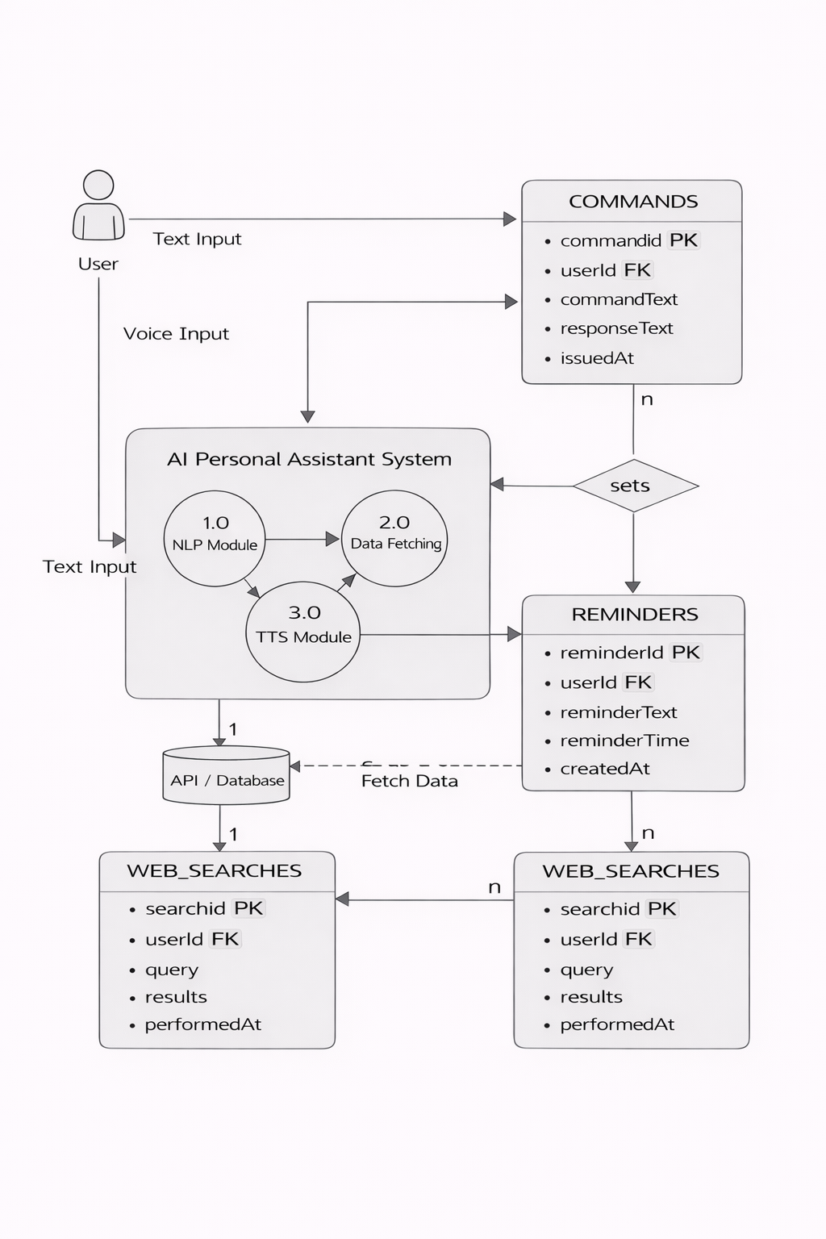
SYSTEM DESIGN
DFD (Data Flow Diagram)

Slide 11
SYSTEM DESIGN
DFD (Data Flow Diagram)
Data Stores
SQLite Database
Normalized Text StringStores Courses
Operation Status / Output String
Local Storage Layer
Data Flow
User Input ➔ Signal Normalization ➔ Intent Logic ➔
Parallel Execution (Local OS / Gemini API) ➔ Output Synthesis ➔ User Feedback.
External Entity
User
Local OS (WINDOWS)
Google gemini API
Main Process
1.0 Receive Input
2.0 Intent classification (MASTER LOGIC)
3.0 Executive local command
4.0 Query AI model
5.0 Generate Output

Slide 12
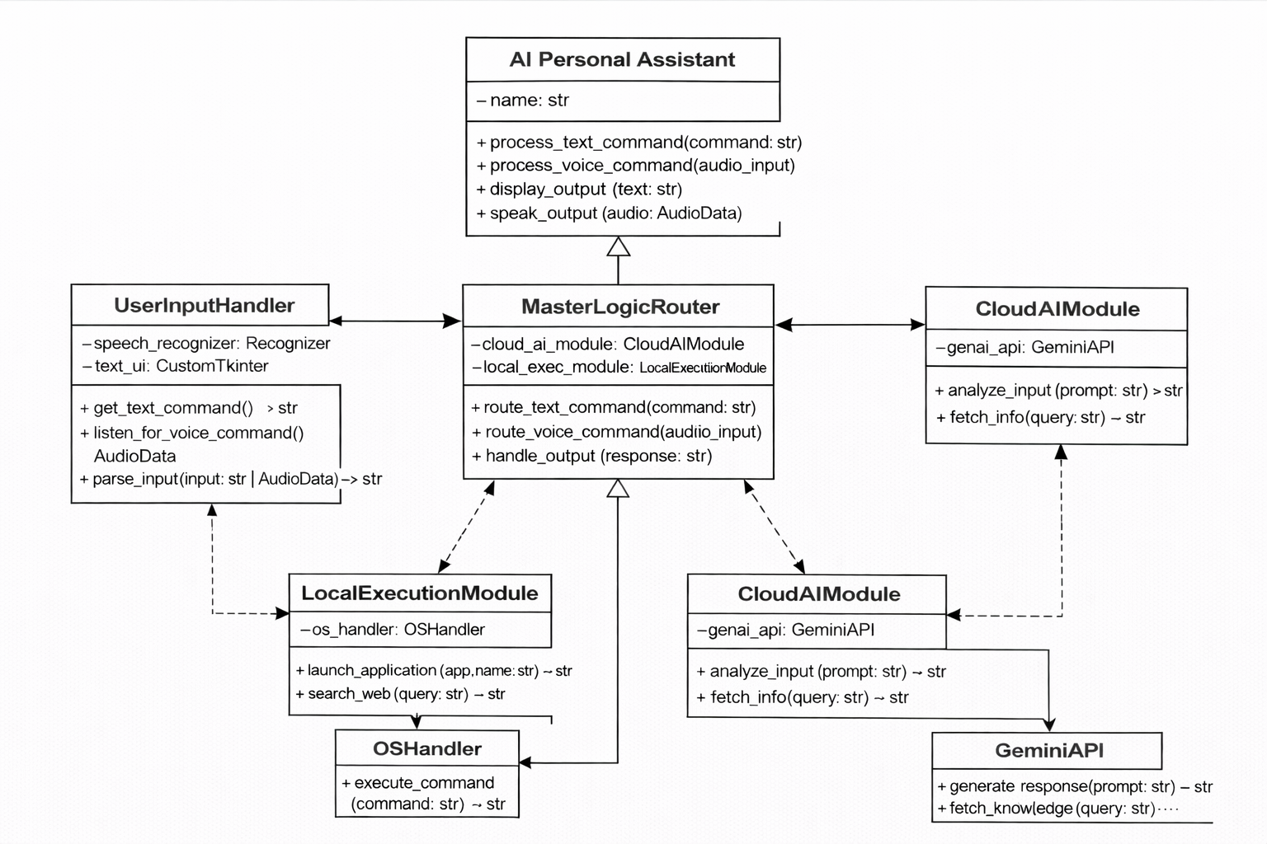
SYSTEM DESIGN
CLASS DIAGRAM
Class Diagram Example: GUI

Slide 13
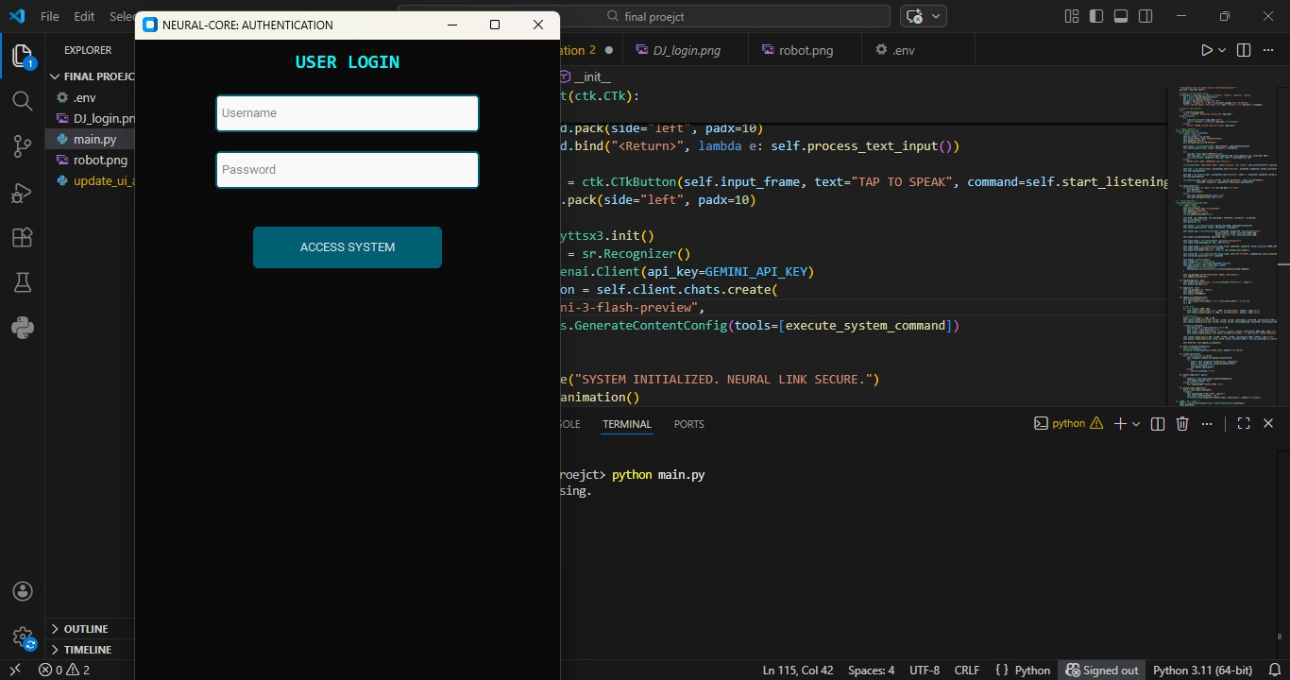
IMPLEMENTATION
Login Page:
.

Slide 14
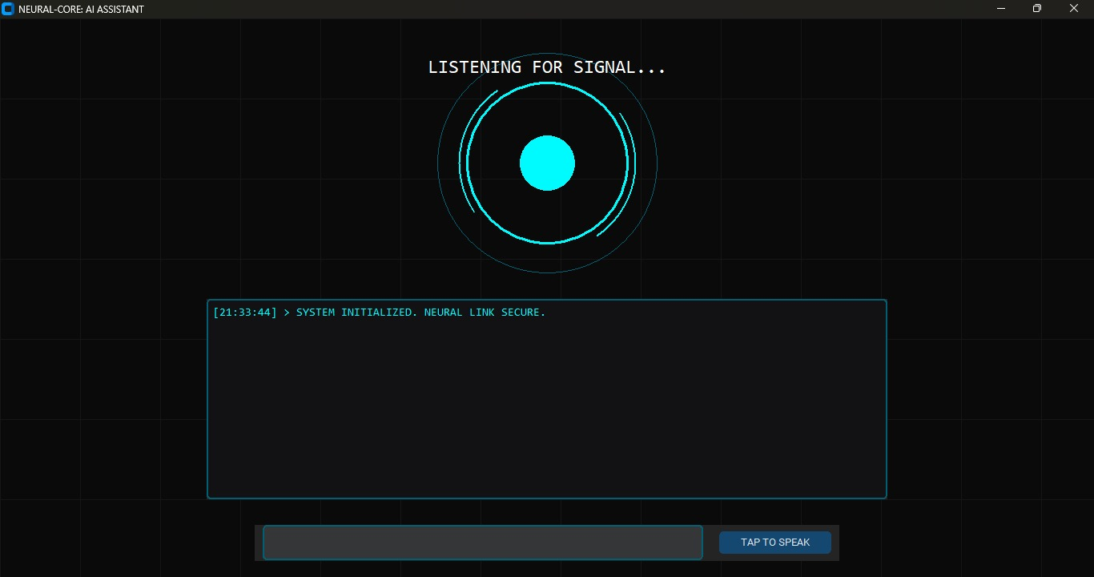
Home Page:

Slide 15
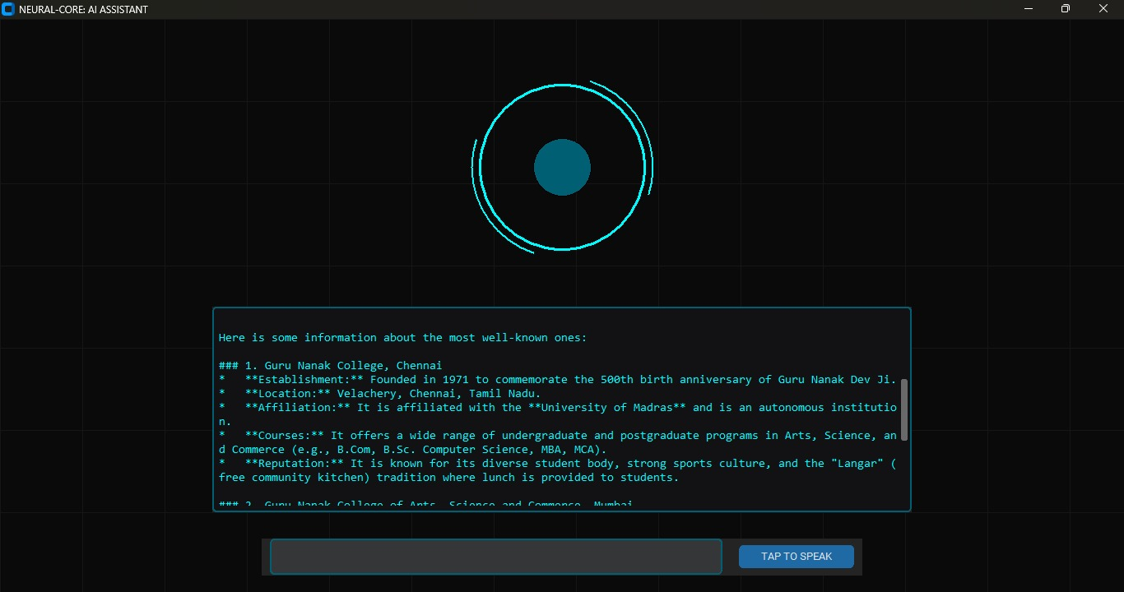
Output: Seaching

Slide 16
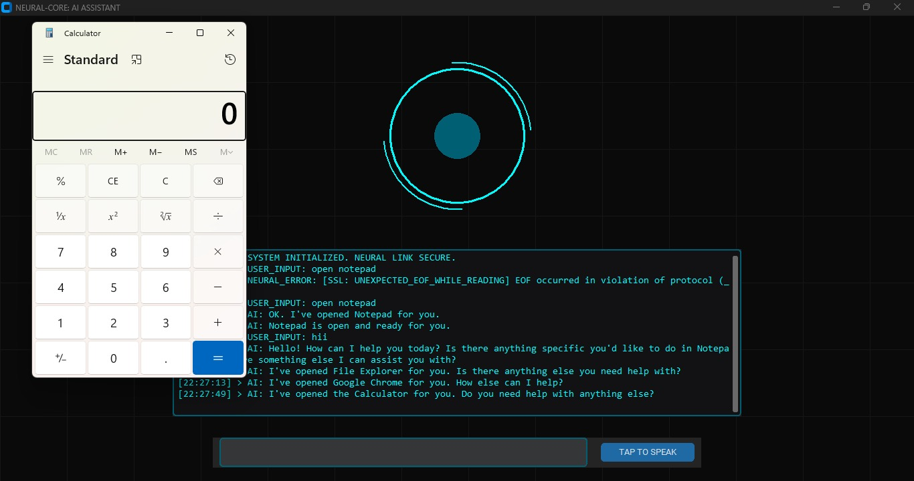
Output: Command

Slide 17
TESTING
1. Functional Testing
Verify root authentication and login function
Checked system tool activatin (notepad and vs code)
Tested real time hardware telemetry retrieval
Validate voice to text accuracy under noise
2. API & CLOUD Testing
Google gemini 1.5 flash api connectivity verified
Intent classification latency tested
Secure data transmission to cloud confirmed

Slide 18
TESTING
3. Result
Application working successfully without major errors
All modules (voice, ai, os execution) functioning as expected

Slide 19
CONCLUSION
SYSTEM BENEFITS
Provides an autonomous desktop interface for hands-free computer management and automation
Empowers users to monitor hardware health and launch local applications using natural language
Ensures high-speed intent classification and conversational intelligence via gemini 1.5 flash
Offers a technical and user-friendly terminal environment with real-time visual and audio feedback
OVERALL PERFORMANCE
All core modules including voice capture, logic routing, and execution function correctly
Secure api communication between the python backend and cloud services is verified
Local system operations and hardware telemetry retrieval perform with minimal latency
The application has been successfully tested on windows for responsiveness and accuracy

Slide 20
FUTURE ENHANCEMENT
Integration of machine learning models for localized, offline anomaly detection in system behavior
Connecting with smart iot sensors for real-time environmental data monitoring and automation
Development of a cross-platform mobile application for remote desktop management and system control
Implementation of cloud deployment for data scalability and cross-device profile synchronization
Advanced hardware analytics with graphical performance reports and historical system health summaries
Enhanced natural language processing for supporting multi-lingual voice commands and localized dialects

